Slide 1
Wind Turbine Generator Failure Prediction
Introduction to Neural Networks

Slide 2
Contents / Agenda
Executive Summary
Business Problem Overview and Solution Approach
Data Overview
EDA Results
Data Preprocessing
Model Evaluation Criterion
Model Performance Summary
Test Performance of Best Model
Appendix

Slide 3
Executive Summary
The best model obtained is a neural network that achieves a recall of 92% overall and 84% on the "failure" class, along with high precision and F1-scores.
With only 68 false positives, the inspection costs remain manageable. The model does not overburden maintenance teams with unnecessary inspections, aligning well with cost efficiency.
Focus on Reducing False Negatives (FN)
The 43 undetected failures (FN) can lead to replacement costs, which are significantly higher than repair costs. To further minimize these, consider enhancing the model by incorporating additional predictive features in the original data or using ensemble techniques to improve recall for failures.

Slide 4
Executive Summary
Implement Predictive Maintenance Protocols
Use the model's predictions to establish a tiered maintenance protocol:
Prioritize generators predicted to fail (class 1) for immediate repair.
Perform routine inspections on non-failure cases (class 0) to verify the model's predictions and refine future iterations.
Monitor Cost Trade-offs and Update Models Regularly
Continuously monitor the balance between inspection, repair, and replacement costs. Regularly update the model with new sensor data to adapt to changes in equipment performance and environmental conditions, ensuring sustained accuracy and cost savings

Slide 5
Business Problem Overview and Solution Approach
Renewable energy sources play an increasingly important role in the global energy mix, as the effort to reduce the environmental impact of energy production increases.
Predictive maintenance uses sensor information and analysis methods to measure and predict degradation and future component capability. The idea behind predictive maintenance is that failure patterns are predictable and if component failure can be predicted accurately and the component is replaced before it fails, the costs of operation and maintenance will be much lower.
The task is to make a robust predictive model which can correctly predict whether a generator will result in a failure to operate or not. The approach is to try out several neural network models and choose the one which performs the best.

Slide 6
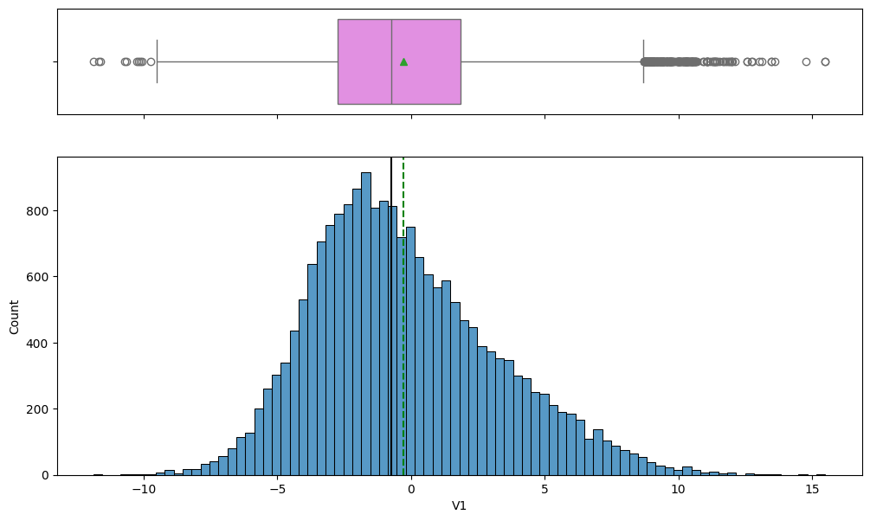
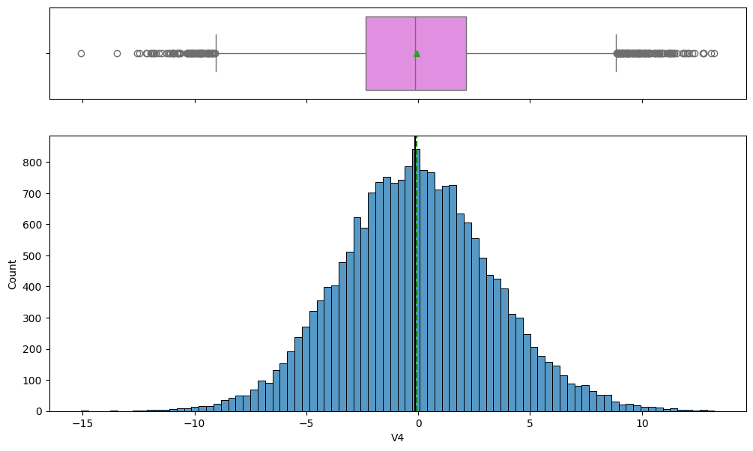
EDA Results - Univariate
All variables through V1 to V40 are approx. normally distributed and scaled.
There are no outliers in the data.

Slide 7
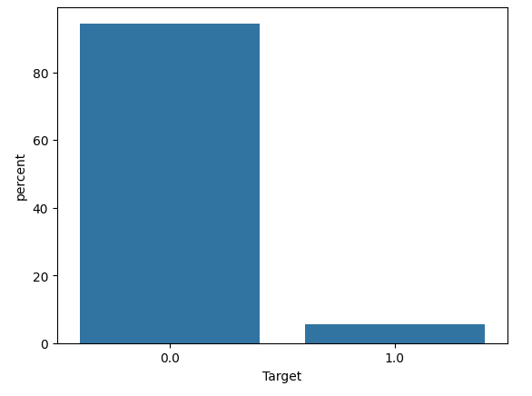
EDA Results - Univariate
There is high class imbalance with 0 class constituting more than 80% of the data.

Slide 8
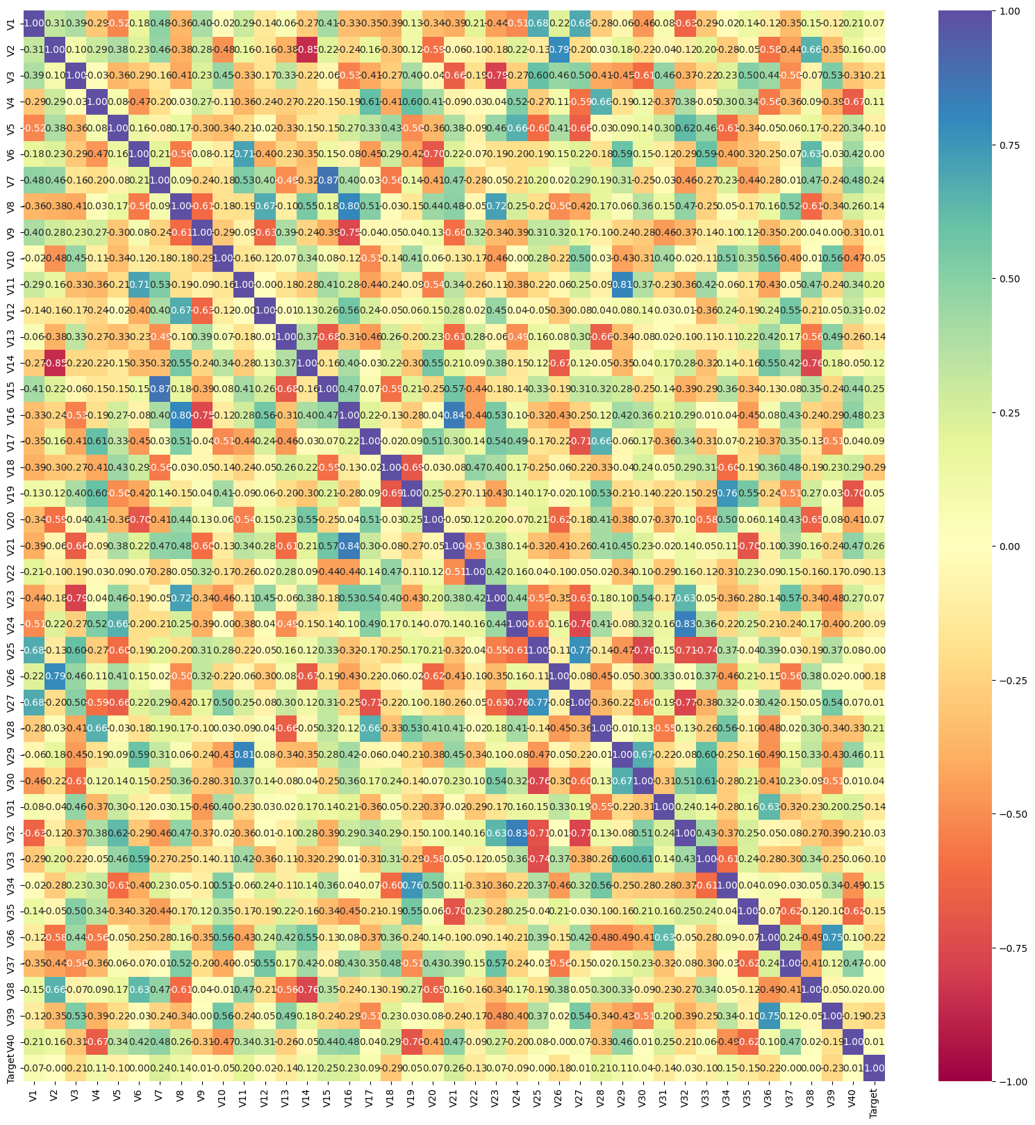
EDA Results - Bivariate
Variables through V23 to V33 how higher correlation among themselves than other variables.
The target variable shows low correlation overall with the independent variables.

Slide 9
Data Preprocessing
There are no duplicate values in both test and training set.
We changed the datatype of the target variable from integer to float.
Data is already scaled and distributed approx. normally.
Since a test set is already available, we are splitting the training data into train and validation with validation size = 0.25.
There are 0.090% missing values in V1 and 0.090% missing values in V2 in training set. There are 0.1% missing values in V1 and 0.12% missing values in V2 in the test set.
These missing values are imputed using median after the train-validation split to account for data leakage.

Slide 10
Model Evaluation Criterion
We need to choose the metric which will ensure that the maximum number of generator failures are predicted correctly by the model.
We would want Recall to be maximized as greater the Recall, the higher the chances of minimizing false negatives.
We want to minimize false negatives because if a model predicts that a machine will have no failure when there will be a failure, it will increase the maintenance cost.

Slide 11
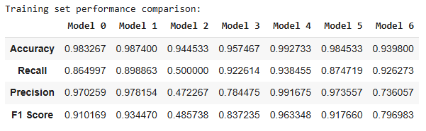
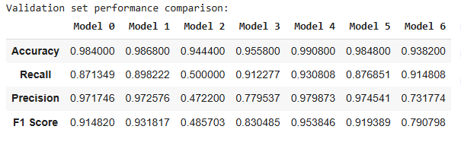
Model Performance Summary
We can observe that Model 4 performs the best and achieves the highest recall on both the training and validation sets
This model is a neural network with 3 hidden layers, Adam optimizer, and no regularization or class weight adjustment
We'll choose this as our final model

Slide 12
APPENDIX

Slide 13
Data Overview
The training dataset has 20000 rows and 41 columns
The test dataset has 5000 rows and 41 columns.
Out of 41 columns, 40 columns are of type float64 and the target column is categorical.

Slide 14
Model Architectures
Model | Hidden | Optimizer | Dropout | Class Weights
0 (Base) | 1 | SGD | No | No
1 | 2 | SGD | No | No
2 | 3 | SGD | Yes | No
3 | 3 | SGD | Yes | Yes
4 | 2 | Adam | No | No
5 | 3 | Adam | Yes | No
6 | 3 | Adam | Yes | Yes

Slide 15
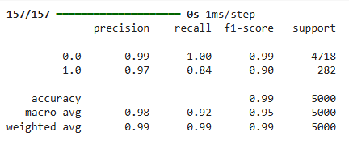
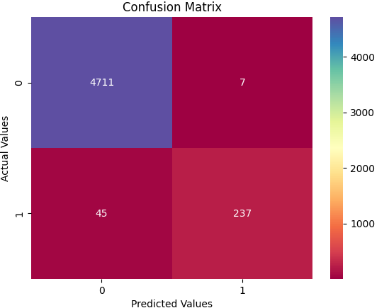
Best Model - Test Performance
The model also performs quite well on the test data. The recall is greater than 0.8 for the "failure" class along with high precision and f1-score.

